Slide 1
World Space Week
Exploring our Universe
Name, job title
DD Month YEAR

Slide 2
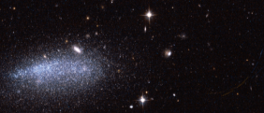
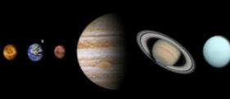
What are we going to talk about today?
Why do we explore Space?
What kind of objects do we explore in Space?
Exploring the planets

Slide 3
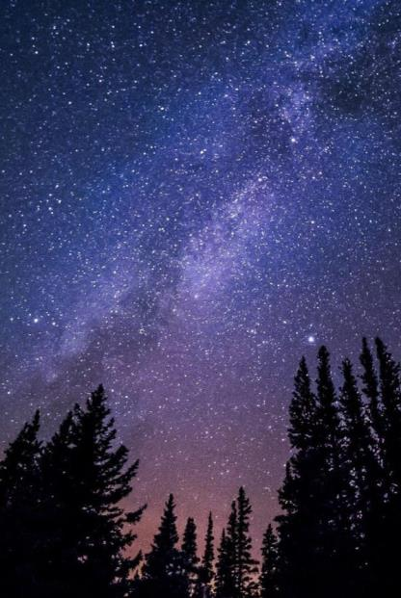
Why do we explore Space?

Slide 4
Why do we explore Space?
Space exploration is essential for learning more about science. It enables us to:
Better understand the World we live in
Observe the birth of the Universe
Understand how galaxies are formed
Analyse what planets are made of
4 main areas:
Planetary exploration
Astronomy
The Sun –heliosphere -magnetosphere
Fundamental physics
Notes:
Space exploration is an essential tool for scientific progress. Space science missions enable us to better understand the World in which we live, observe the birth of the Universe, understand the creation of galaxies, analyse planets’ compositions.
There are 4 important domains:
Planetary exploration
Astronomy
Sun-heliosphere-magnetosphere
Fundamental physics
→ Give a definition of each domain

Slide 5
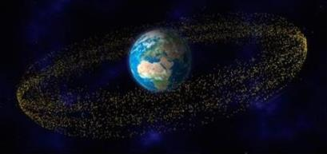
Surviving in a harsh environment
Space puts satellite under extreme conditions. They must survive:
The launch phase (vibrations, shocks, etc.)
Radiation
Extreme temperatures (-150°C to +200°C)
Space vacuum, residual atmosphere, contamination
Space debris
Space debris
Notes:
Space puts satellites under extreme conditions. They must survive:
The launch phase (vibrations, shocks, etc.)
Radiations
Extreme temperatures (-150°c à +200°c)
Space vacuum, residual atmosphere, meteorites, contamination
Space debris

Slide 6
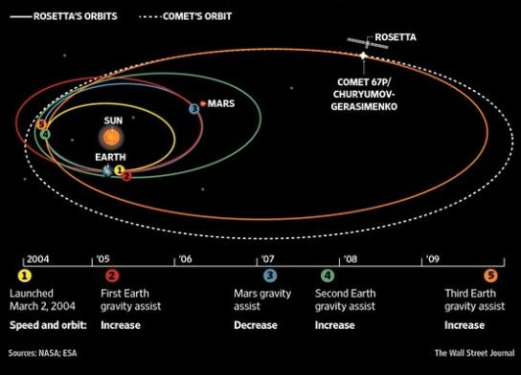
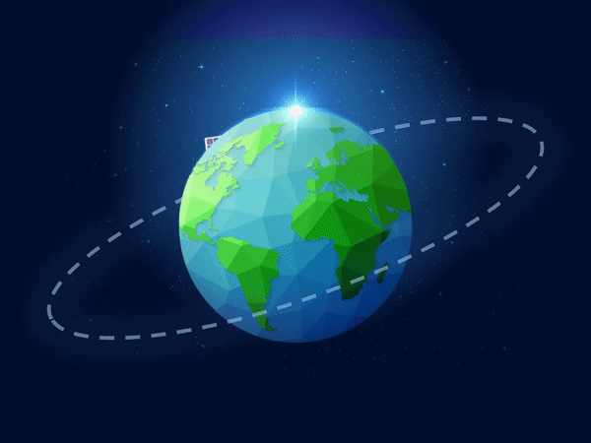
Special orbits for exploration missions
For exploration missions, engineers have to come up with a very precise idea of what they want to achieve.
Here is an example of Rosetta’s trajectory during its 10-year journey in Space.
In orbit, satellites have to do their job alone, for a long time and with no repair service anywhere in sight!

Slide 7
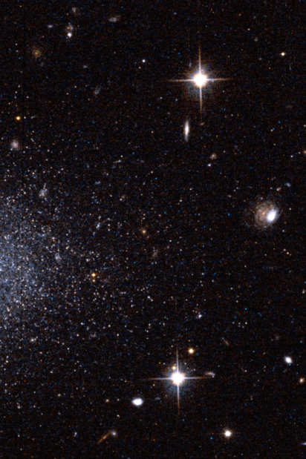
What kind of objects do we explore in Space?

Slide 8
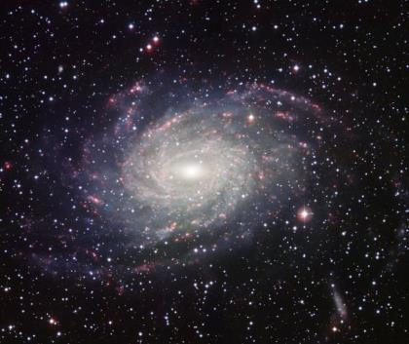
Questions
How many stars are there in the Milky Way?
©ESO
Why is it so hard to count them?
Notes:
How many stars are there in the Milky Way?
The Milky Way is the galaxy where Earth is found. Part of it is visible on a clear night from Earth, as a thick band of stars stretching across the sky. We can see thousands of these stars with the naked eye, and many more through a telescope. But the real answer is we don’t really know. Astronomers estimate that it is between 100 and 400 billion stars and at least that many planets.
Why is it so difficult to count?
Imagine looking at only the front view of a large building and try calculating the number of bricks used to build it. Only with the assumption of its size in mind, the end result would be very inaccurate. We are, sort of, in same situation where only one side of our galaxy is fairly visible to us (the other side is obscured by gas and dust in the galactic centre). The best we could do was to map one part of our galaxy and extrapolate it to the other side since our galaxy is believed to be spiral.

Slide 9
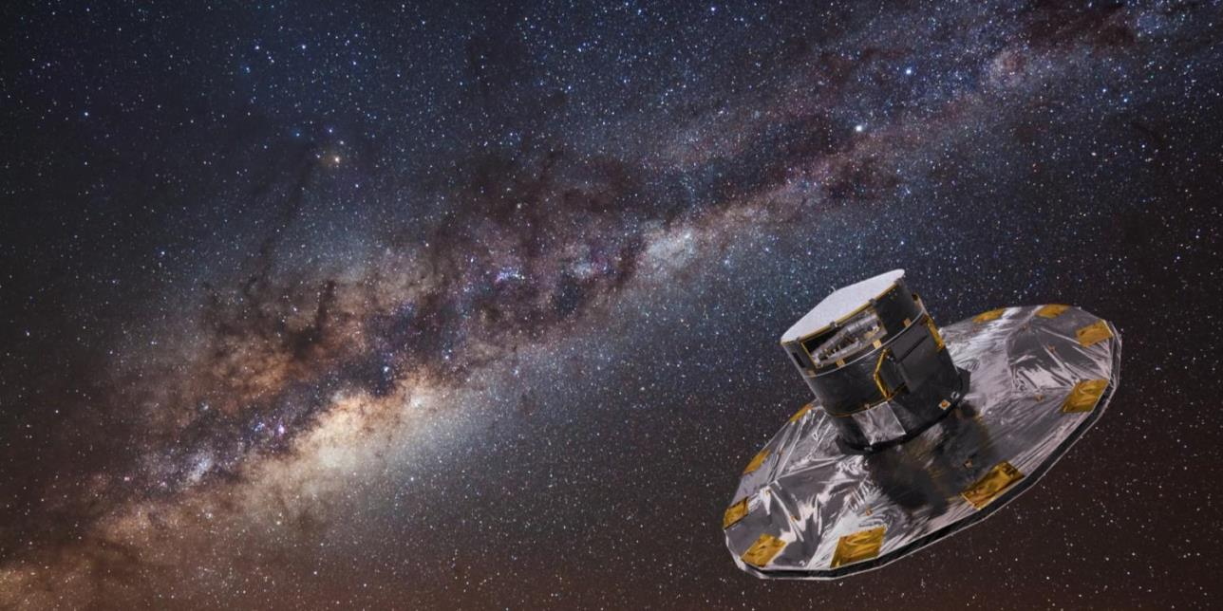
What is Gaia?
Gaia is a space observatory launched by the European Space Agency on 19th December 2013.
It is making a 3D map of the universe with 1 billion astronomical objects.

Slide 10
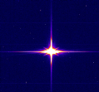
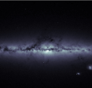
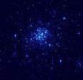
Gaia, mapping over a billion stars
Gaia …
… is equipped with the largest digital camera ever built for a space mission: 1,000,000,000 pixels!
… is so accurate that if it were on the Moon, it could measure the thumbnail of a person on Earth
Camera: 24,000,000 de pixels
iPhone 11 pro: 12,000,000 pixels
… makes very precise measurements of stars: their position, colour, brightness, how they move and surface temperatures
Notes:
https://www.esa.int/kids/en/learn/Our_Universe/Stars_and_galaxies/Gaia_satellite_maps_over_a_billion_stars
https://kids.kiddle.co/Gaia_(spacecraft)

Slide 11
Gaia, mapping over a billion stars
Gaia …
… is gathering information on 1 billion objects, only 1% of objects in the Milky Way
… is gathering information on stars beyond our Galaxy, asteroids within our Solar System and even distant quasars!
… will help us understand the origin of our universe and the evolution of our galaxy
Notes:
Quasar definition: bright galaxies powered by the activity of the supermassive black holes at their cores
https://www.esa.int/kids/en/learn/Our_Universe/Stars_and_galaxies/Gaia_satellite_maps_over_a_billion_stars
https://kids.kiddle.co/Gaia_(spacecraft)

Slide 12
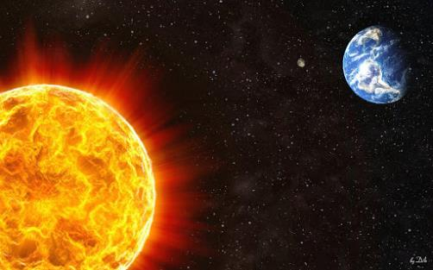
Questions
What is the Sun?
Why is it so difficult to go to the Sun?
Notes:
https://nineplanets.org/kids/sun/
https://www.nasa.gov/feature/goddard/2018/its-surprisingly-hard-to-go-to-the-sun
What is the Sun?
It is the most important source of energy for life on Earth. The Sun is located in the centre of the Solar System. It is a nearly perfect sphere of hot plasma, essentially, a hot ball of glowing gases. The Sun has a diameter of around 1.39 million kilometres, 109 times greater than the diameter of our planet.
Why is it difficult to go to the Sun?
It's surprisingly hard to actually go to the Sun: It takes 55 times more energy than it does to go to Mars. Why? The answer lies in the same fact that keeps Earth from plunging into the Sun: Our planet is traveling very fast — about 67,000 miles per hour — almost entirely sideways relative to the Sun. The only way to get to the Sun is to cancel that sideways motion.

Slide 13
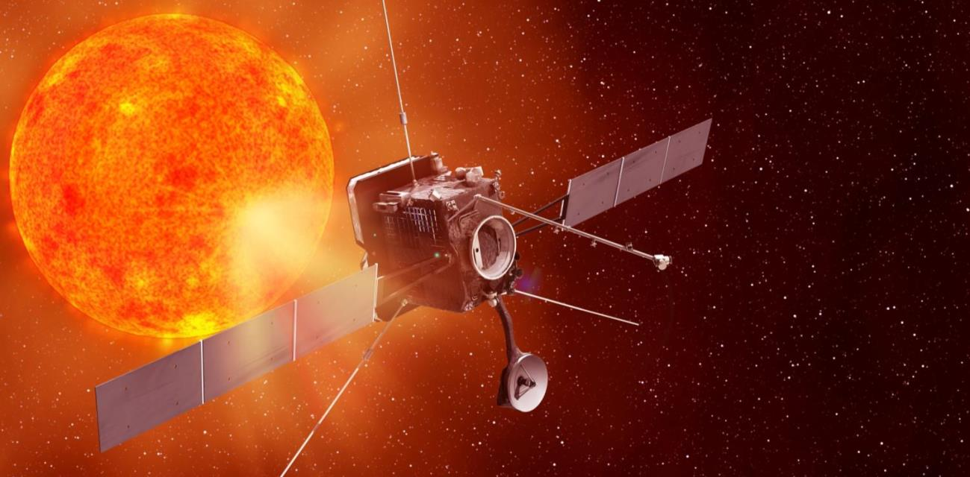
What is Solar Orbiter ?
Solar Orbiter is a probe designed to operate near to the Sun.
It will give us the first ever views of the top and bottom of the Sun, as well as investigating connections between
the Sun and Earth

Slide 14
Solar Orbiter, investigating the Sun’s secrets
Solar Orbiter …
… will take 1.8 years to reach its orbit around the Sun with a total of 8 fly-bys of the Earth and Venus to reduce its velocity until it reaches its final destination
…will be 42 million km from the Sun at closest approach (closer than Mercury!)
… will study the Sun’s surface and outer atmosphere (the corona) with an unprecedented resolution of 70km / pixel
… will help understand the effects of solar wind and large solar eruptions on communications and navigation systems on Earth

Slide 15
Solar Orbiter, investigating the Sun’s secrets
Solar Orbiter …
… will have to withstand temperatures as high as 600°C when close to the Sun and as low as -180°C when in deep space
… will have a communications window to Earth for 8 hours per day
… weighs 1800kg in total: approximately the same as an iconic London taxi cab
… will not overheat thanks to its protective heat shield, kept in place thanks to space-qualified metallic Velcro

Slide 16
Questions
What is a comet?
©ESA
Why are comets important?
Notes:
What is a comet?
Comets are frozen leftovers from the formation of the solar system composed of dust, rock and ice. They range from a few miles to tens of miles wide, but as they orbit closer to the sun, they heat up and spew gases and dust into a glowing head that can be larger than a planet. This material forms a tail that stretches millions of miles.
Why are comets important?
Comets are important because they:
May be the oldest, most primitive bodies in the solar system preserving the earliest record of material from the nebula which formed the sun and the planets
Bring volatile light elements to the planets, playing a role in forming oceans and atmospheres
Are the most organic-rich bodies in the solar system providing ready-formed molecules possibly involved in the origin of life on Earth
Impact the Earth and other planets at hyper-velocities, causing major changes in climate and dramatically affecting the ecological balance, possibly including the extinction of the dinosaurs.
Are the building blocks of planetary systems around other stars.
https://solarsystem.nasa.gov/asteroids-comets-and-meteors/comets/overview/?page=0&per_page=40&order=name+asc&search=&condition_1=102%3Aparent_id&condition_2=comet%3Abody_type%3Ailike
https://stardust.jpl.nasa.gov/comets/comets.html

Slide 17
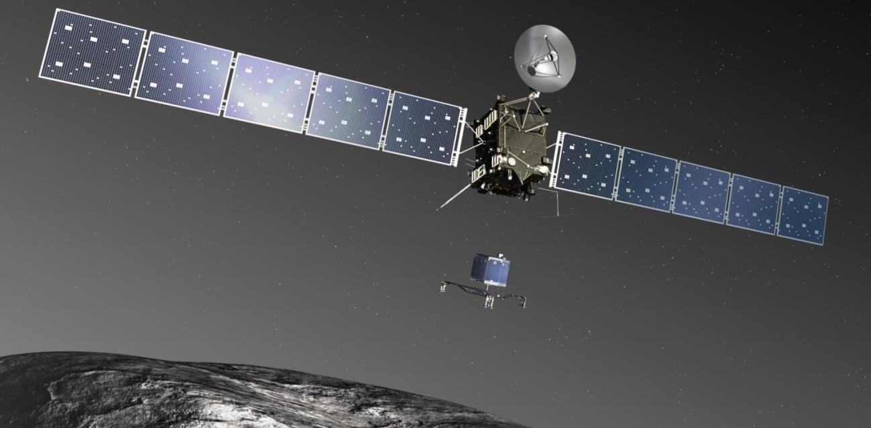
What is Rosetta?
Rosetta made the most detailed study of a comet ever attempted, following the comet on its journey through the inner Solar System
Philae, the first lander to successfully land on a comet, took images and analysed samples around its landing site

Slide 18
Rosetta, the comet chaser
Rosetta…
… was named after the famous stone that helped decipher Egyptian hieroglyphics almost 200 years ago
… has produced a wealth of data to help scientists unlock the mysteries of the oldest building blocks of our Solar System – the comets
… travelled nearly 8 billion km in 10 years
… hibernated for 957 days to save energy, using the equivalent power of 6 light bulbs and surviving without assistance from Earth
… was the 1st spacecraft to closely examine how a frozen comet is activated and
transformed by the warmth of the Sun

Slide 19
Rosetta, the comet chaser
Philae…
… was named after the island in the river Nile where the obelisk that helped to translate the hieroglyphs of the Rosetta stone was found
… was released from a height of about 1km. Touchdown took place at walking speed – less than 1 metre per second!
… weighed 100 kg on Earth but only 1g on the comet!
… bounced 3 times before settling in a crater and performed 57 hours of science operations
… obtained the 1st images from a comet’s surface and made the 1st in situ analysis to learn what a comet is made of

Slide 20
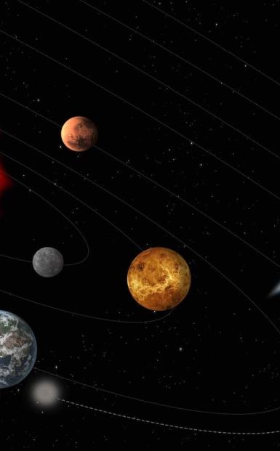
Exploring the planets

Slide 21
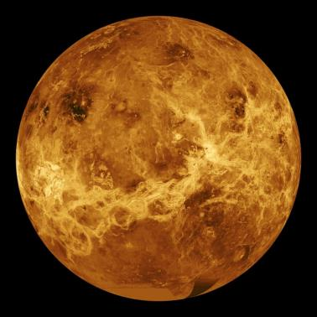
Questions
Why is Venus so important for Earth?
©NASA
Notes:
Venus is Earth's closest neighbour in the solar system. It isn't the closest planet to the Sun, but it is the hottest in our solar system with temperatures that can melt lead (480 degrees Celsius), an atmosphere so thick it would crush you, and clouds of sulfuric acid.
The planet is a little smaller than Earth, and is similar to Earth inside. We can't see the surface of Venus from Earth, because it is covered with thick clouds. However, space missions to Venus have shown us that its surface is covered with craters, volcanoes, mountains, and big lava plains.
Now superheated by greenhouse gases, Venus' climate was once more similar to Earth's, with a shallow ocean's worth of water. It is believed that Venus and the Earth started out with the same composition, the same water and carbon dioxide. And they've gone down two completely different paths. Why? Scientists believe that Venus could tell us something vitally important about our planet: what happened to the superheated climate of our planetary twin, and what does it mean for life on Earth?

Slide 22
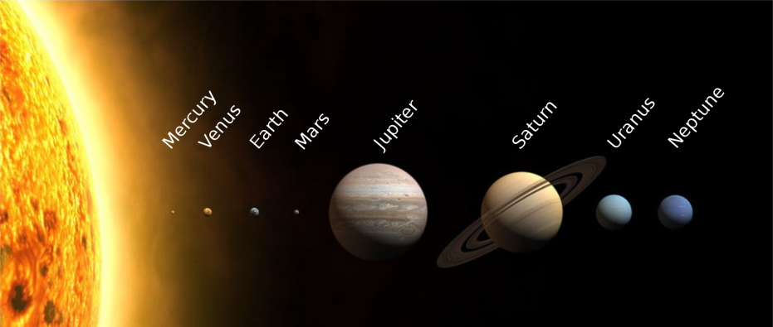
Where is Venus?
Sun
Right here
©Wikipedia

Slide 23
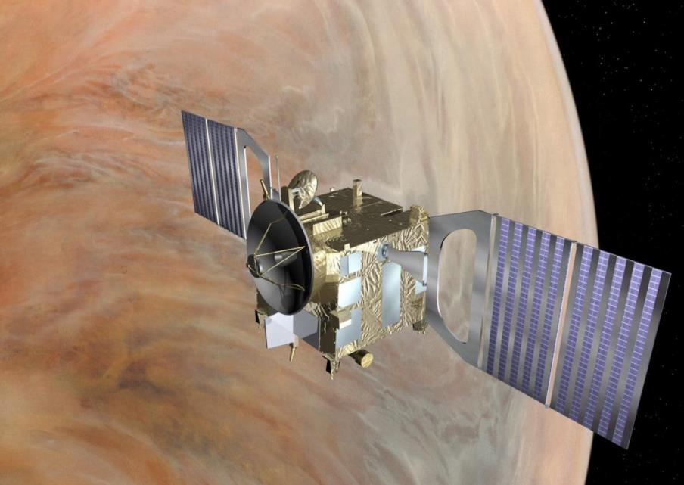
Venus Express
Venus Express was Europe's 1st spacecraft to travel to our nearest planet.
It studied the planet's complex dynamics and chemistry, and the interactions between the atmosphere and the surface, which provided clues about the surface characteristics.

Slide 24
Venus Express, visiting our closest neighbour
Venus Express…
… was the 1st European mission to Venus and the 1st spacecraft to perform an overall investigation of the Venusian atmosphere
… investigated the noxious atmosphere and clouds in detail and made global maps of the planet’s surface temperature
… was built in only 33 months hence its name Venus Express
… took 155 days to reach Venus and 5 more days to reach operational orbit

Slide 25
Venus Express, visiting our closest neighbour
Venus Express…
… used the same design as the Mars Express mission and borrowed instrument technology from the comet chaser Rosetta
… arrived at Venus in April 2006 for a 500 day mission. After 5 extensions, it finally sent its last signal in January 2015
… performed a series of aerobraking manoeuvres during which it dipped deeper into the atmosphere than it had before, allowing exploration of previously uncharted regions of the atmosphere

Slide 26
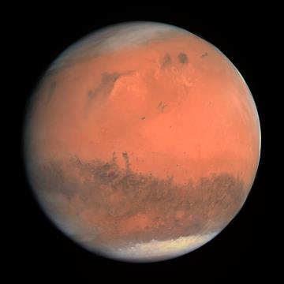
Questions
What is Mars?
©Wikipedia
Why go to Mars?
Notes:
What is Mars?
Mars is a planet. It is the fourth planet from the Sun and the next planet after Earth. Mars is more than 142 million miles from the sun. The planet is about one-sixth the size of Earth. Mars is known as the Red Planet. It gets its red colour from the iron in its soil. Mars has two small moons. Their names are Phobos and Deimos.
Why go to Mars?
Understanding whether life existed elsewhere in the Universe beyond Earth is a fundamental question of humankind. Mars is an excellent place to investigate this question because it is the most similar planet to Earth in the Solar System. Evidence suggests that Mars was once full of water, warmer and had a thicker atmosphere, offering a potentially habitable environment.

Slide 27
Where is Mars?
Sun
Right here
©Wikipedia

Slide 28
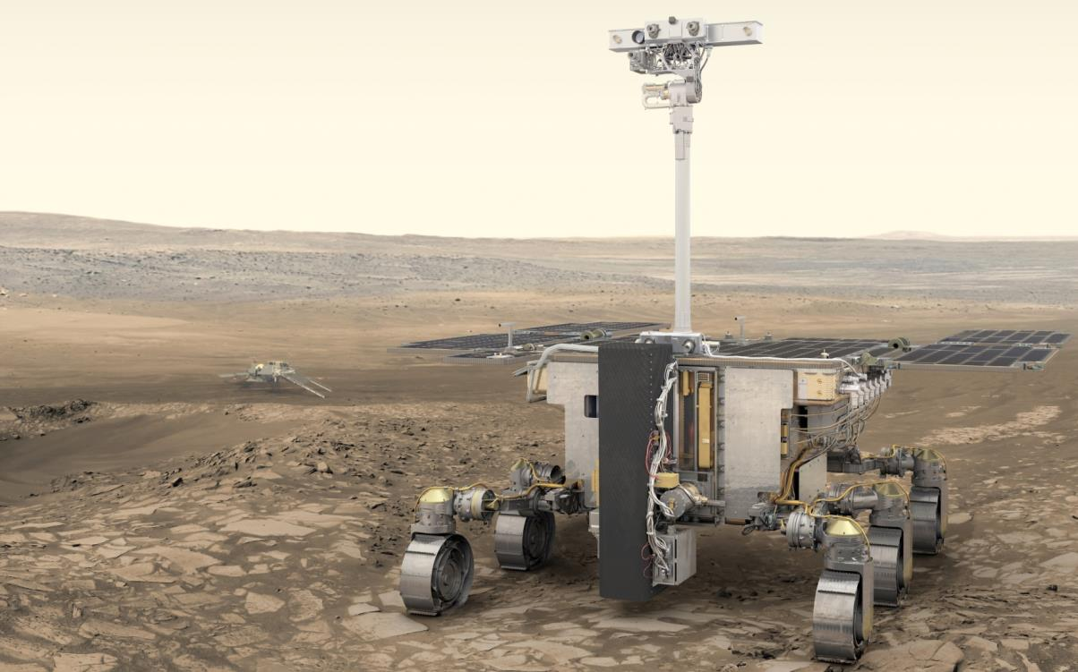
What is ExoMars?
ExoMars is the European Space Agency’s programme to explore the Martian environment.
The ExoMars Rover mission will pioneer new ways to explore the surface of Mars and carry out advanced science, looking for evidence of past or present life.

Slide 29
Looking for life on Mars with the ExoMars Rover
ExoMars Rover Rosalind Franklin…
… is named after the prominent scientist who discovered the structure of DNA
… is the first Mars rover specifically designed to find evidence of past or present life
… carries nine experiments to analyse the physical and chemical properties of Martian samples
… Has a two metre drill to collect samples from below the surface which are protected from the harsh solar radiation
… cannot carry anything that could contaminate Mars so it was manufactured in a special clean facility

Slide 30
Looking for life on Mars with ExoMars Rover - Rosalind Franklin
ExoMars Rover Rosalind Franklin…
… has to withstand night-time temperatures down to -120°C and day-time temperatures up to -50˚C to 40˚C
… travels at a maximum speed of 2 centimetres per second on flat ground and is expected to travel up to 4km over the 6-month mission
… has 6 flexible metal wheels as rubber cannot be sent to Mars because it is an organic material
… communicates with Earth twice every Martian day via a radio link using orbiting satellites
… may have a radio signal delay of up to 20 minutes each way between Earth and Mars

Slide 31
Mars Sample Return, bringing Mars down to Earth

Slide 32
Mars Sample Return, bringing Mars down to Earth
Mars Sample Return – Earth Return Orbiter…
…is part of an incredible international campaign involving 3 separately launched missions, which will together achieve the objective of returning the first ever Mars samples to Earth before the end of 2031
… will take about a year to reach Mars, complete a 3 year mission in Mars orbit and take another year to make its way back to Earth
… is the final part of the mission. It will have to detect, rendezvous with, and capture the basketball-size sample container housing the samples collected on the red planet; over 50 million km away from ground control

Slide 33
Mars Sample Return, bringing Mars down to Earth
Mars Sample Return – Earth Return Orbiter…
… will weigh 6 tons, be 6 metres high and 40 metres wide
… will be equipped with the biggest solar panels ever made for an interplanetary mission: 144m²!
… will release the sample container close to Earth. After landing, the samples will be transferred to a specialised handling facility where they will be quarantined
… will be part of the European contribution to the campaign. Another part is the Sample Fetch Rover that will be tasked to find and collect the samples on Mars

Slide 34
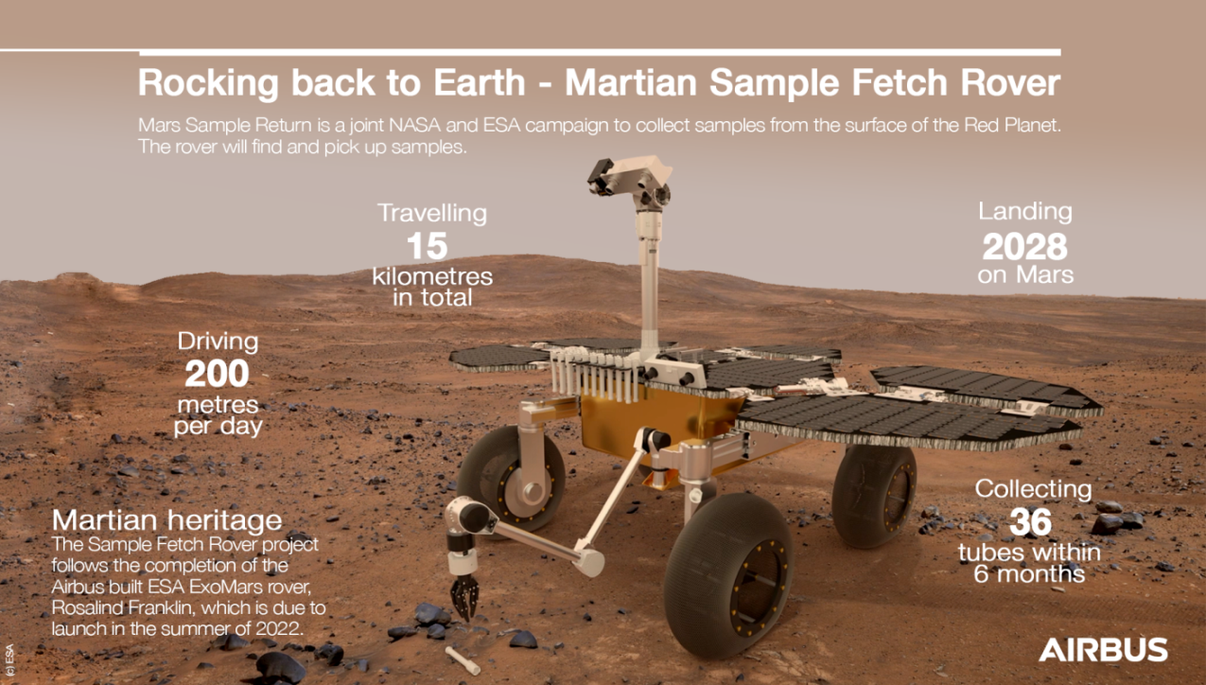

Slide 35
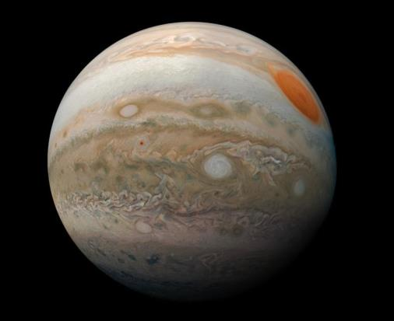
Questions
Why go to Jupiter?
©NASA
Notes:
Why go to Jupiter?
Jupiter is the 5th planet from our Sun and is, by far, the largest planet in the solar system. It is approximately 143,000 kilometres wide at its equator. Jupiter is so large that all of the other planets in the solar system could fit inside it. Jupiter is called a gas giant. Its atmosphere is made up of mostly hydrogen gas and helium gas, like the sun. The planet is covered in thick red, brown, yellow and white clouds. The clouds make the planet look like it has stripes.
Because Jupiter is so big, it has had a significant influence on the solar system. By learning about Jupiter, we can better understand the early history of the solar system and the conditions in which Earth was born.

Slide 36
Where is Jupiter?
Sun
Right here!
©Wikipedia

Slide 37
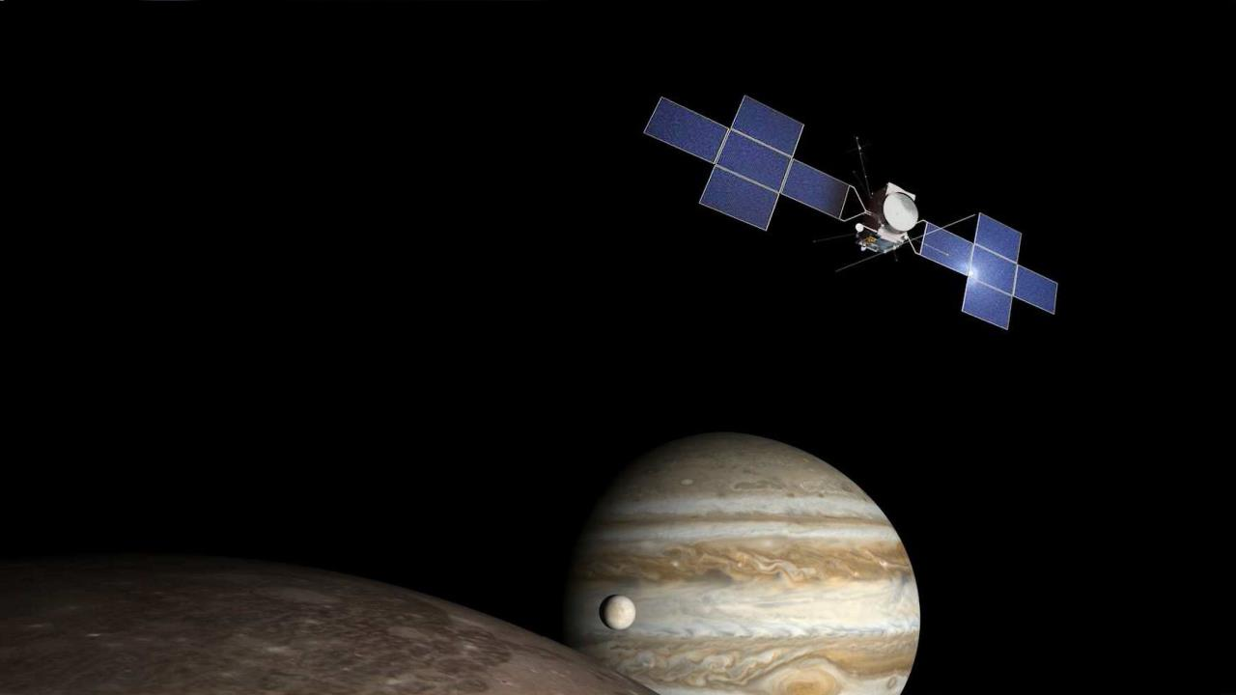
What is JUICE?
JUICE is Europe’s first mission to Jupiter.
The mission will investigate the Jovian system, with a focus on its icy moons and the possibly ocean-bearing worlds of Europa, Ganymede and Callisto.
Notes:
JUICE is Europe’s first mission to Jupiter.
The mission will investigate the Jovian system, with a focus on its icy moons and the possibly ocean-bearing worlds of Europa, Ganymede and Callisto.

Slide 38
JUICE, investigating Jupiter and its icy moons
JUICE…
… is the 1st European mission to Jupiter and the 1st spacecraft ever to enter orbit around an icy moon in the outer Solar System
… will have a very long mission. Set for launch in 2022, it will reach Jupiter in 2029 and end its mission in 2033
… will take almost 8 years, 3 gravity assist manoeuvres around the Earth and 1 around Venus to reach Jupiter
Notes:
http://www.spaceopedia.com/space-exploration/space-probes/other-solar-bodies/icy-moons-explorer/

Slide 39
JUICE, investigating Jupiter and its icy moons
JUICE…
…will use 85m² of solar panels to generate electrical power despite Jupiter’s distance from the Sun
…will produce a wealth of data on the icy Jovian moons that are of particular interest to scientists as they are believed to have (or once had) liquid oceans of water making them potentially habitable
… will end its mission by spending 8 months orbiting around Ganymede, the largest moon in our Solar System (larger than Mercury and Pluto!) and the only one known to possess a magnetic field

Slide 40
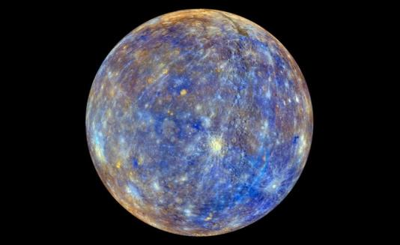
Questions
Why do we know so little about Mercury?
©NASA
Notes:
Mercury is the smallest of the 8 planets in our solar system. It is also the closest to the sun. Mercury is the least explored of the four rocky planets of the inner Solar System and is also notoriously difficult to observe from Earth.
Difficult to observe - Being the innermost planet of the Solar System, it always appears too close to the Sun. Mercury sets and rises in the sky almost at the same time as the Sun. That means it can be spotted only briefly, shortly before sunrise and just after sunset, and always appears close to the horizon.
Hard to reach - Surprisingly, despite being much closer to Earth than Jupiter and Saturn, Mercury is actually more difficult to reach. The reason for that is Mercury’s closeness to the Sun. A spacecraft aiming to enter into orbit around the planet directly has to constantly brake against the gravitational pull of the star.
Too hot to orbit up close - Not only is sunlight around Mercury about 10 times stronger than near Earth, the planet’s scorched surface also radiates heat back to space. As a result, spacecraft have to endure temperatures of up to 450°C, hot enough to melt lead. Materials used in standard space missions are not capable of withstanding such high temperatures. For example standard solar arrays start falling apart at 140°C.
https://www.esa.int/Science_Exploration/Space_Science/BepiColombo/Three_reasons_why_we_know_so_little_about_Mercury

Slide 41
Where is Mercury?
Sun
Right here!
©Wikipedia

Slide 42
What is BepiColombo?
BepiColombo is Europe’s first mission to Mercury, the least known of the inner planets.
It will study the composition, geophysics, atmosphere, magnetosphere and history of the closest planet to the Sun.

Slide 43
BepiColombo, uncovering Mercury’s mysteries
BepiColombo…
… is named after Giuseppe Colombo, a scientist who studied Mercury's orbit, and helped lay the groundwork for interplanetary travel
… is the 1st European mission to Mercury and only the 2nd spacecraft to orbit Mercury in the entire history of planetary exploration
… will travel through space for over 7 years and use 9 planet fly-bys to slow down (1x Earth, 2x Venus, 6x Mercury) before reaching Mercury
… will separate into 2 spacecraft after reaching its destination. The Mercury Planetary Orbiter will study the surface of Mercury and investigate the inside of the planet while the Mercury Magnetospheric Orbiter will study its magnetic field

Slide 44
BepiColombo, uncovering Mercury’s mysteries
BepiColombo…
… will be exposed to radiation from the Sun that is 10 times stronger than around Earth
… is protected from melting as Mercury’s scorching surface can reach 470 °C, which is hot enough to reflect heat toward the probes in orbit
.. will use its electric propulsion system to brake for an accumulated period of 2 years
… will be able to communicate with the Earth with a delay of only 13 mins. When the spacecraft is behind the Sun then communication will not be possible for as long as 21 days

Slide 45
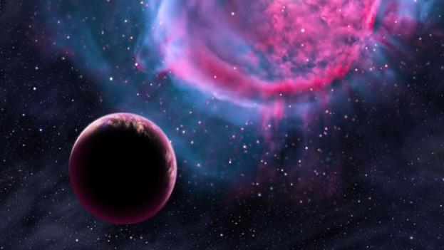
Questions
Why do scientists search for exoplanets?
©Adam Clark Estes
Notes:
Exoplanets are planets that orbit a star other than our sun. Astronomers have confirmed more than 4,000 exoplanets orbiting distant stars, with at least 1,000 more awaiting confirmation.
Why didn’t we see them before? It’s because exoplanets are so far away, several light-years away at their closest. And it’s because – unlike stars – exoplanets don’t shine with their own light. Like our own Earth, they shine only with light reflected from their local stars. In contrast to their stars, exoplanets are exceedingly dim; even the largest are drowned in the light of their vastly brighter stars. That’s why, even now, even the largest are too small to be glimpsed in optical telescopes, although a few have been directly imaged.
The discovery of exoplanets has increased interest in the search for extra-terrestrial life. There is special interest in planets that orbit in a star's habitable zone, where it is possible for liquid water, a prerequisite for life on Earth, to exist on the surface. The study of planetary habitability also considers a wide range of other factors in determining the suitability of a planet for hosting life.
https://earthsky.org/astronomy-essentials/what-are-exoplanets

Slide 46
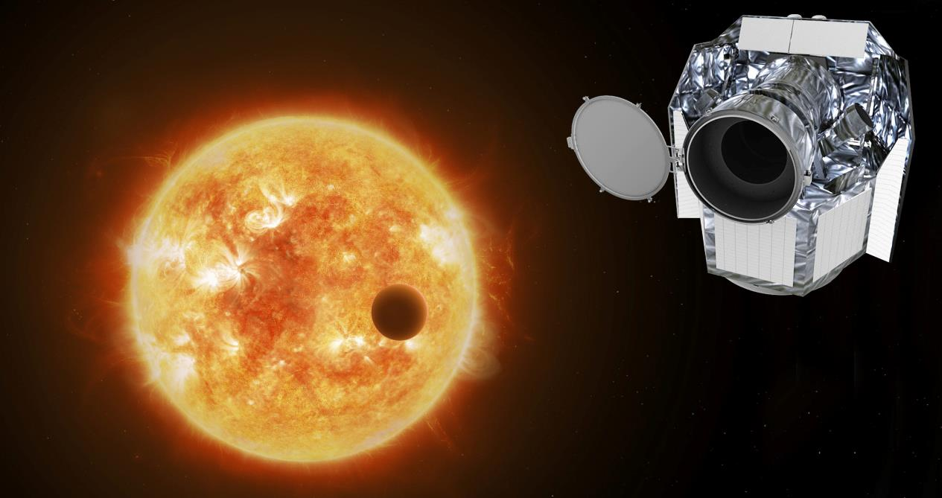
What is CHEOPS?
CHEOPS is the 1st mission dedicated to studying bright, nearby stars that are already known to host exoplanets.
The mission is making high-precision observations of the planet's size as it passes in front of its host star.

Slide 47
CHEOPS, a close look at exoplanets
CHEOPS…
… weighs just 273 kg, and is fairly compact – with external dimensions of 1.5 x 1.5 x 1.5 metres in a hexagonal shape
… is not looking for new exoplanets but studying those we already know in detail
… will enable scientists to begin to piece together what exoplanets are made of, how they form, and how they evolve

Slide 48
CHEOPS, a close look at exoplanets
CHEOPS…
… will return to specific stars to observe repeated transits of the same exoplanet in an effort to improve characterization accuracy and precision
… will help future space telescope missions identify the most suitable, and potentially habitable, exoplanets to target in the search for water and methane signatures in the exoplanets’ atmospheres
… will focus primarily on super-Earth to Neptune mass exoplanets in the 1 to 6 Earth radii size range

Slide 49
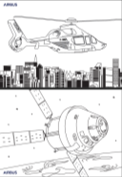
Want to learn more?
@AirbusSpace
Spacecrafts colouring books
https://fly.airbus.com/airbus-colouring-book
@Airbus Defence and Space
@Airbus Space
@Airbus_Space
@Airbus Defence and Space

Slide 50
Thank you
Confidential and proprietary document.
This document and all information contained herein is the sole property of Airbus. No intellectual property rights are granted by the delivery of this document or the disclosure of its content. This document shall not be reproduced or disclosed to a third party without the expressed written consent of Airbus. This document and its content shall not be used for any purpose other than that for which it is supplied.
Airbus, it’s logo and product names are registered trademarks.
Icon made by Icongeek26 from www.flaticon.com
Icon made by Good Ware from www.flaticon.com
Icon made by Freepik from www.flaticon.com
Icon made by eucalyp from www.flaticon.com
Icon made by Pixel perfect from www.flaticon.com
Icon made by Monkik from www.flaticon.com
Icon made by Smashicons from www.flaticon.com
Icon made by Smalllikeart from www.flaticon.com
Icon made my Inipagistudio from www.flaticon.com
Icon made by Pharplus from www.flaticon.com
Icon made by Surang from www.flaticon.com

