Slide 1
THE MOON - Moon gate stars
- kingdom of Saudi Arabia - Primary School 32 Onaizah

Slide 2
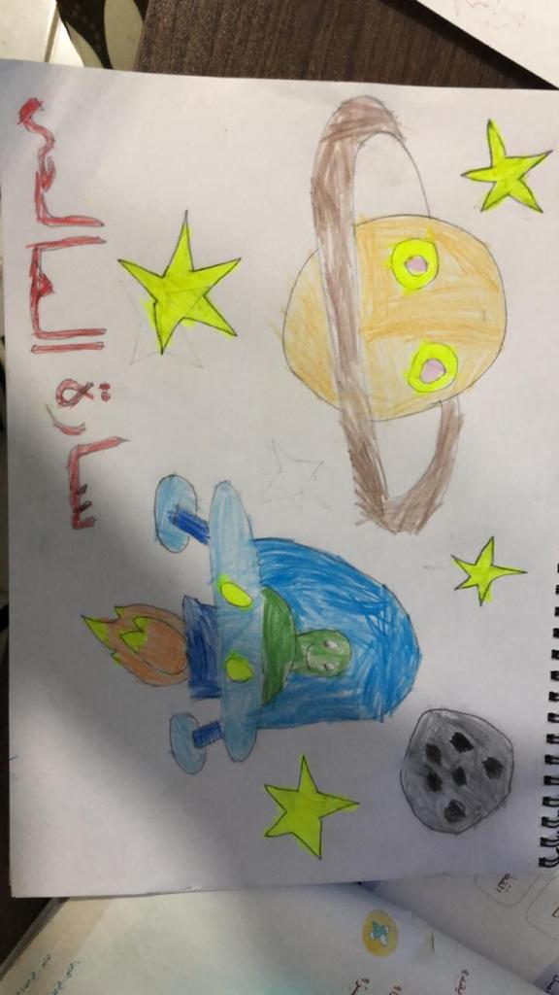
sarah al salihi

Slide 3
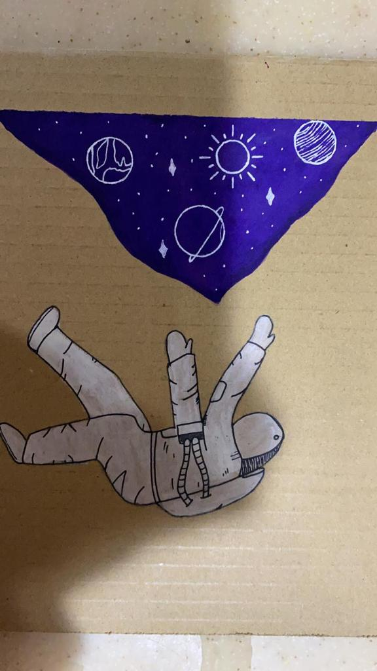
lana alsaeed

Slide 4
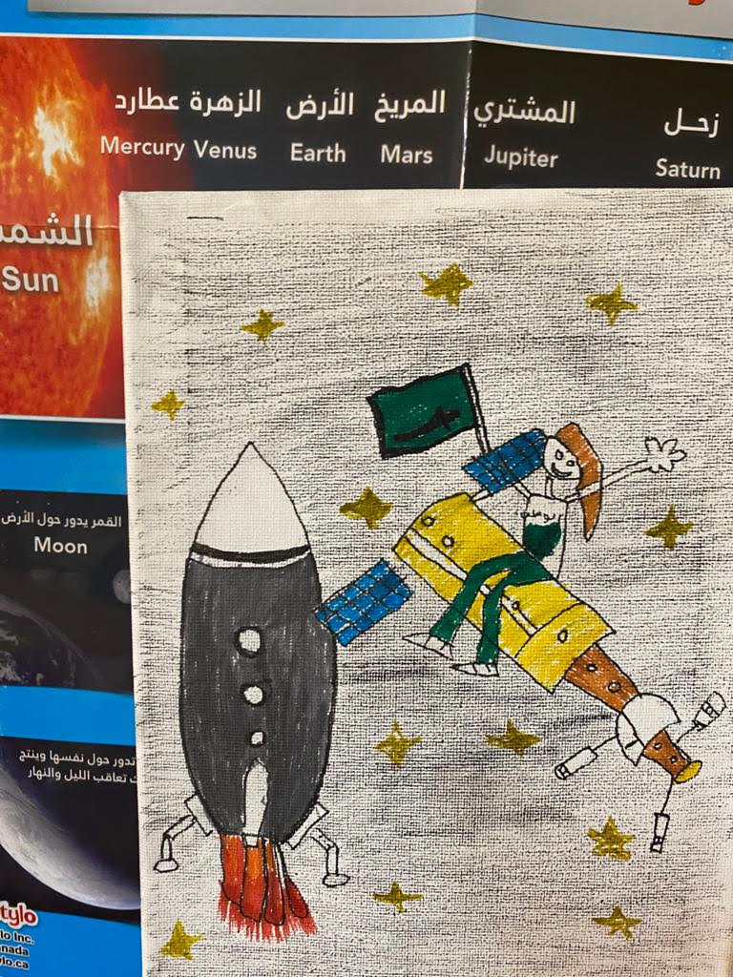
'amir al sabil

Slide 5
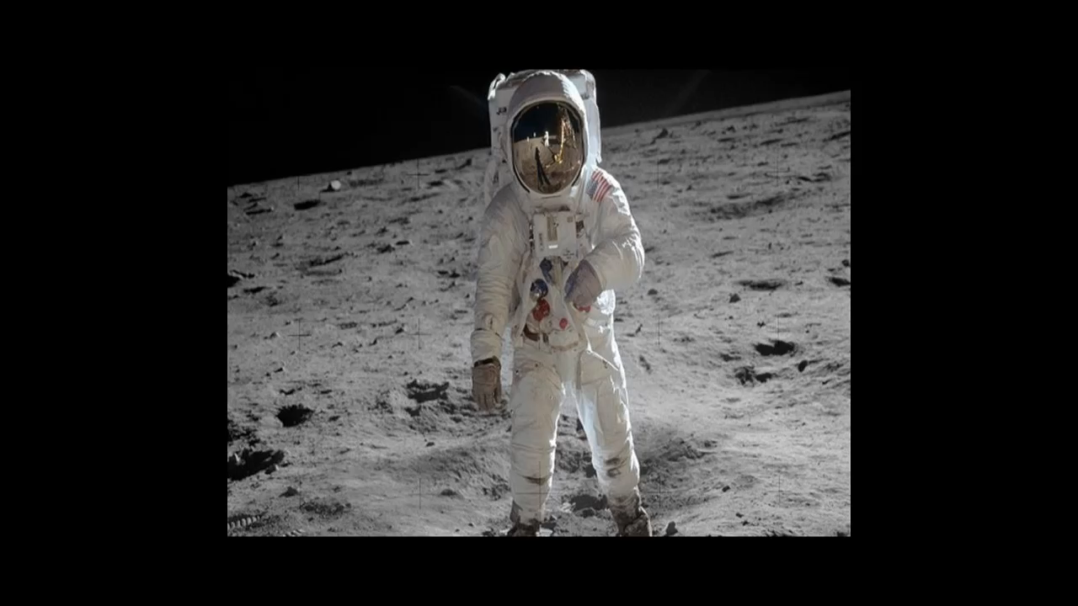
mis wadana alfilio

